Slide 1
Scientific review: Inventory Routing Problem → Follow-up of the EURO/ROADEF challenge 2016 organized by Air Liquide

Slide 2
Contents
Inventory Routing Problem: State of the art
Background on the resolution approaches to solve huge size combinatorial optimization problems
Resolution approaches of our IRP proposed in the challenge
What next? Follow-up of the challenge: Proposed action Plan
Notes:
Filling Centre

Slide 3
0
EURO/ROADEF Challenge
Reminder

Slide 4






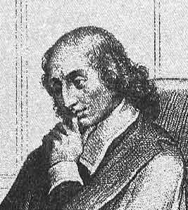
The 2016 Euro/Roadef Challenge
The Operations Research European & French Societies organize every 2 year since 1999 an OR-oriented mathematical challenge in collaboration with industrials
The scope of the 2016 challenge is to propose methods that can solve real-life Inventory Routing Problems.
The competition is: Obtain the minimum logistic ratio (€/kg) over 30 test instances.
Everything is publicly available on the challenge website
...
1658: B. Pascal proposes the first mathematical challenge

Slide 5
1
Inventory Routing Problem (IRP) : State-of-the art

Slide 6
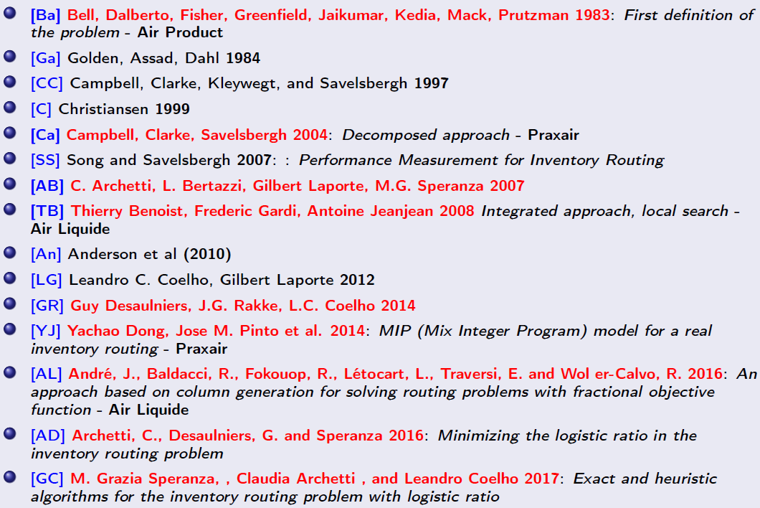
State of the art
1983
2004
2007
2008
2014
2016
2017

Slide 7
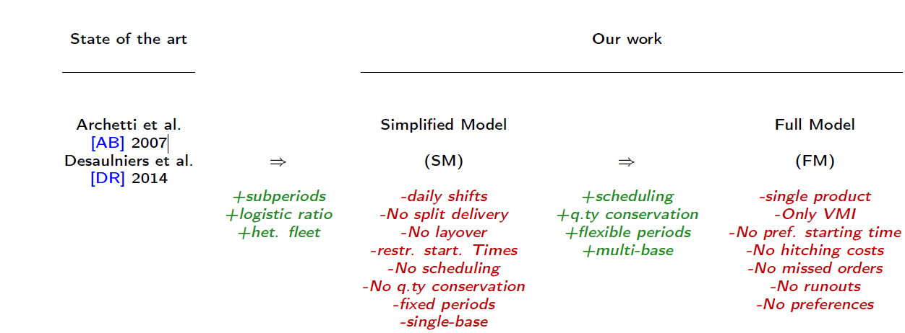
State of the art vs challenge scope

Slide 8
Challenge vs TENOR Scope
TENOR
~50%
~75%
100%
Qualification phase:
Challenge Scope
100%
1 Depot
1 unlimited source of 1 product.
1 driver -> 1 trailer, no tractors
VMI customer only, available 24/7
Driver availability & driving time constraints only
No layovers
Logistic ratio as cost function
Final phase
1 product, multiple sources.
many drivers, many trailers , no tractors
VMI and call-in customers
Simplified layovers policy
Customer Opening hours
customers, vehicle compatibility
Driver availability & driving time constraints only
Min Operation Quantity
multiple products, multiple depots, multiple sources.
many drivers, many trailers , many tractors
Complete layovers policy, start times
Customer and sources opening hours
Sources, customers, vehicle compatibility
Availability constraints of all resources
Driving time & working time constraints
Surrogate Logistic ratio
Tenor scope

Slide 9
Complexity of Instances for the Challenge
Mainly taken from a short list of well-known Tenor contexts from IM & HC: ALSF, ALE Healthcare, ALFI and serious game.
Instances were simplified and adapted to the challenge problem specifications while ensuring a good feasible solution.
Instances for the qualification are naturally compatible with those of the final phase.
There are multiple variants of the same context with different horizons.
The most difficult instance is coming from ALFI Ile de France: 324 customers and 35 days of optimization horizon.
Qualif/Final | code | Instance Name | Horizon | Nb customers | Layovers | Multisource
Qualification | 1 | Serious Game | 30 | 12 | X | X
 | 2 | Serious Game | 30 | 12 | X | X
 | 3 | ALSF Normandie | 10 | 53 | X | X
 | 4 | ALSF Normandie | 10 | 53 | X | X
 | 5 | ALSF Nord | 10 | 54 | X | X
 | 6 | ALSF Nord | 35 | 54 | X | X
 | 7 | ALSF IDF | 10 | 99 | X | X
 | 8 | ALSF IDF | 3 | 99 | X | X
 | 9 | ALSF IDF | 35 | 99 | X | X
 | 10 | ALSF Sud | 10 | 89 | X | X
 | 11 | ALSF Sud | 35 | 89 | X | X
Final | 12 | ALFI IDF | 10 | 324 | O | X
 | 13 | ALSF Ouest | 10 | 53 | O | X
 | 14 | ALSF Ouest | 35 | 53 | O | X
 | 15 | ALSF Sud | 10 | 134 | O | X
 | 16 | ALSF IDF | 10 | 324 | O | X
 | 17 | ALSF Sud | 35 | 134 | O | X
 | 18 | ALSF Sud | 35 | 134 | O | X
 | 19 | ALSF Ouest | 35 | 53 | O | X
 | 20 | ALSF IDF | 35 | 324 | O | X
 | 21 | ALSF IDF | 35 | 324 | O | X
 | 22 | ALFI IDF | 35 | 324 | O | X
 | 23 | ALFI IDF | 35 | 324 | O | X
 | 24 | ALE Med O2 Portugal | 10 | 32 | X | O
 | 25 | ALE Med O2 Portugal | 35 | 32 | X | O
 | 26 | ALE Med O2 Portugal | 35 | 32 | X | O

Slide 10
2
Background on the resolution approaches to solve large scale combinatorial optimization problems

Slide 11
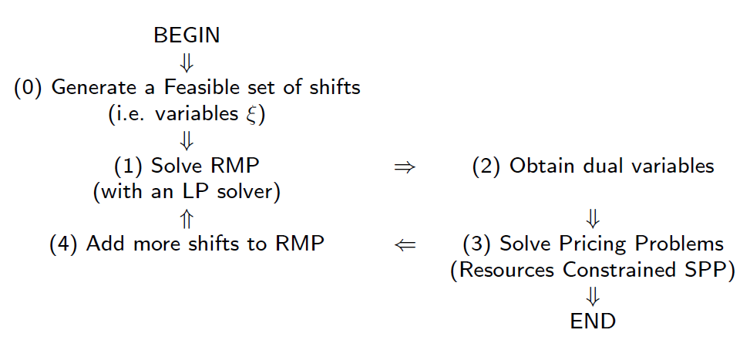
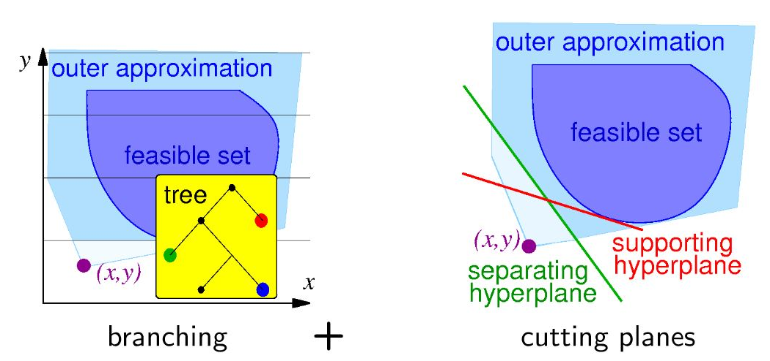
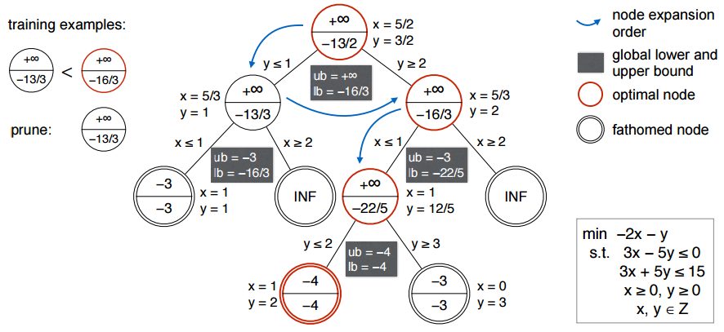
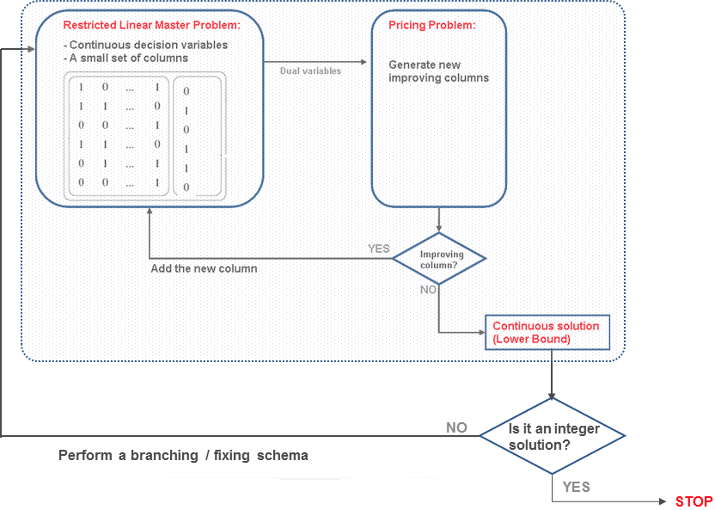
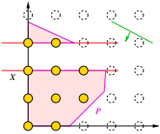
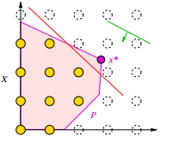
Exact Methods
Branch & Bound
Systematic enumerative method for global optimization of nonconvex and combinatorial problems
Three main components:
a bounding function
a strategy for selecting the live solution subspace to be investigated in the current iteration
a branching rule to be applied
Branch & Price
Branch & Cut

Slide 12
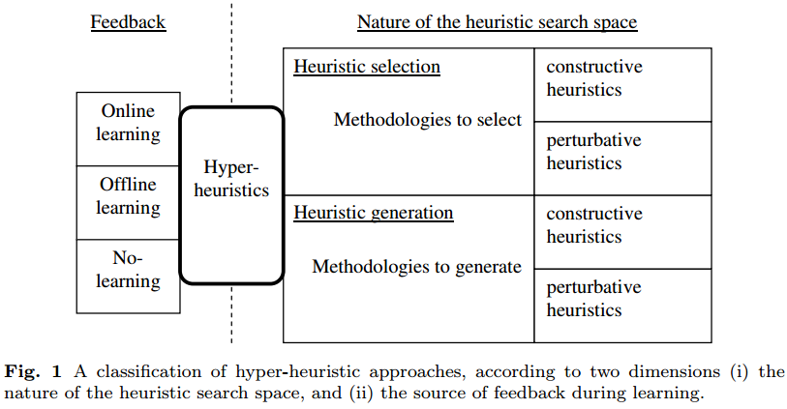
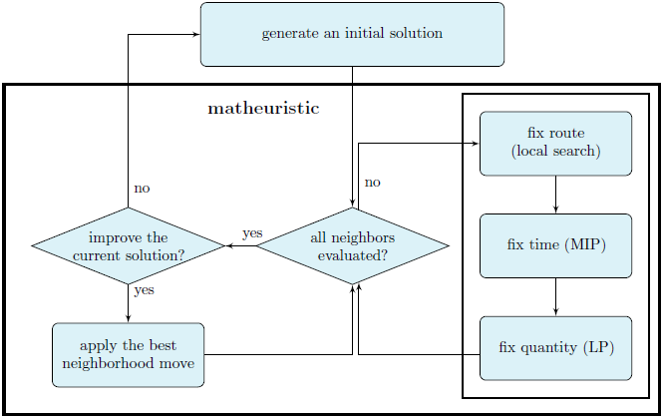
Approached methods
Meta-heuristics
Maths-heuristics
Hyper-heuristics
Higher-level heuristic designed to find, generate, or select a heuristic that may provide a sufficiently good solution to an optimization problem, especially with incomplete or imperfect information or limited computation capacity.
Example
Large neighborhoods search (TENOR)
Step counting hill climbing (2nd team of the challenge)
Combine heuristic with mathematical programming
Example (3rd team of the challenge)
A hyper-heuristic is a search method or learning mechanism for selecting or generating heuristics to solve computational search problems.
Example (1rd team of the challenge)

Slide 13
3
Resolution approaches of our IRP proposed in the challenge

Slide 14
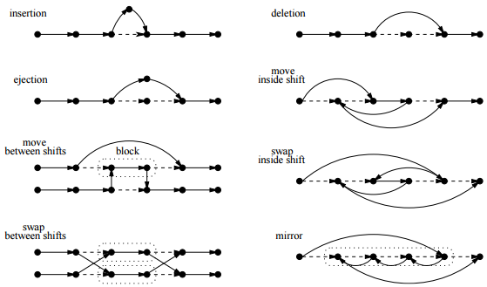
Reminder of our current lexicographic approach (TENOR)
S ← Greedy(I)
Missed order optimization:
while( MO > 0 and timeLimitMO is not reached) do
choose stochastically a move T in the pool TMO ;
evaluate the gain of the application of T to S;
if the gain is not negative then commit T;
else rollback T;
2. Stockout optimization:
while (SO > 0 and timeLimitSO is not reached) do
choose stochastically a move T in the pool TSO ;
evaluate the gain of the application of T to S;
if the gain is not negative then commit T;
else rollback T;
3. Logistic ratio optimization:
while (timeLimitLR is not reached) do
choose stochastically a move T in the pool TLR ;
evaluate the gain of the application of T to S;
if the gain is not negative then commit T;
else rollback T;
return S

Slide 15
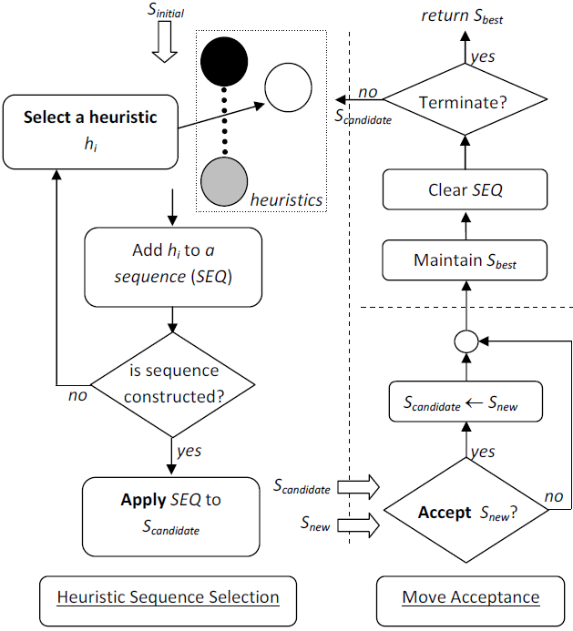
A Sequence-based Selection Hyper-heuristic
(Challenge winner)
A generic sequence-based selection hyper-heuristic framework
Initial solution
Set of low level heuristics(moves)
Transition markov matrix updated at each iteration k with success: Tk(hi ,hj) = probability to select move hj just after the move hi at the iteration k+1
Dynamically define of the sequence moves to apply in the same iteration: AS(hi,l)= probability to limit the sequence of moves
h1
h2
h3
h4
h5
h6
h7
h8
Currently: independent and stochastic selection of the sequence of moves to apply to the current solution in the optimization process

Slide 16
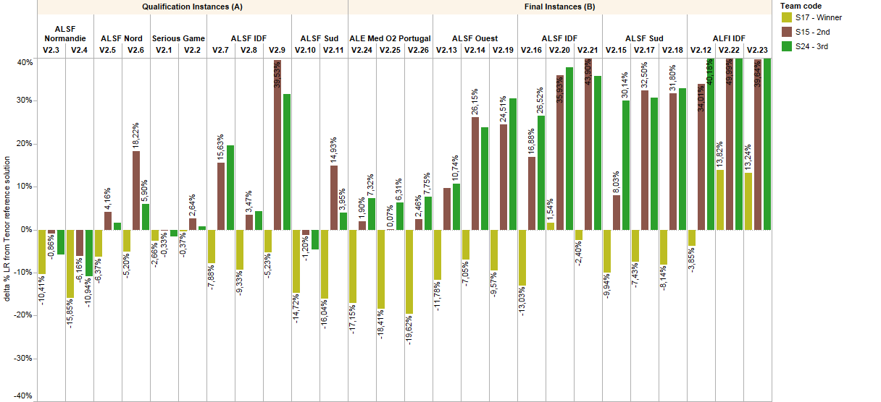
A Sequence-based Selection Hyper-heuristic
(Challenge winner) Result
Worse Full Horizon LR than TENOR
TENOR
Better
Full Horizon
LR than TENOR

Slide 17
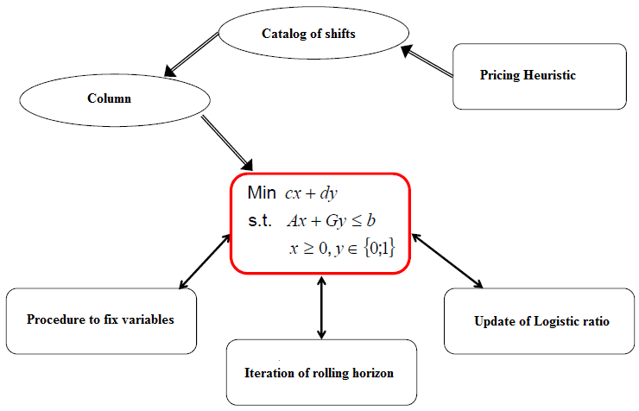
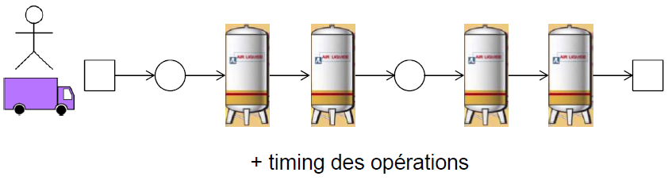
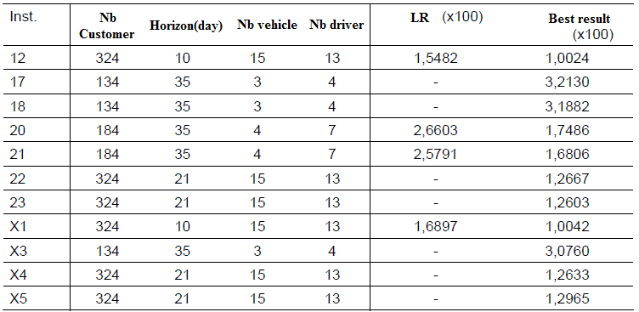
A heuristic branch-cut-and-price algorithm
(Scientific prize winner)
Column definition
Complexity and results:
The number time-stamp shifts is exponential
Some constraints are indexed on the set of shifts, so when we generate new column (variable), we also generate new constraints
Results: poor performances and no additional information concerning the lower bound

Slide 18

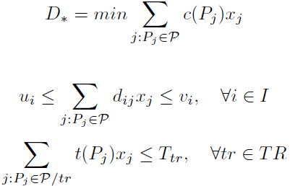
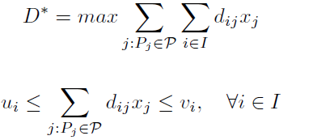


Lower Bound LR-IRP
(Junior Prize winner)
Extension of the work of Song and Savelsbergh - 2007 on Performance Measurement for Inventory Routing (linear objective function) to the LR-IRP.
Delivery Pattern of a trailer definition: Consider an IRP with n customers:
Step 1: Generation of the set of patterns of the base and computation of the pattern time (t(P)) and cost (c(P)) :TSP
Step 2: selection of patterns
( , , , , ) /
...
Minimization Pattern Selection LP
Maximization Pattern Selection LP
d1
d2
d3
dn
Delivery Pattern of the base: at most one customer is partially delivered
Main result used to reduce the size of the lower bound problem: Each delivery pattern can be expressed as convex combination of the patterns of the base
We can just consider the patterns of the base

Slide 19

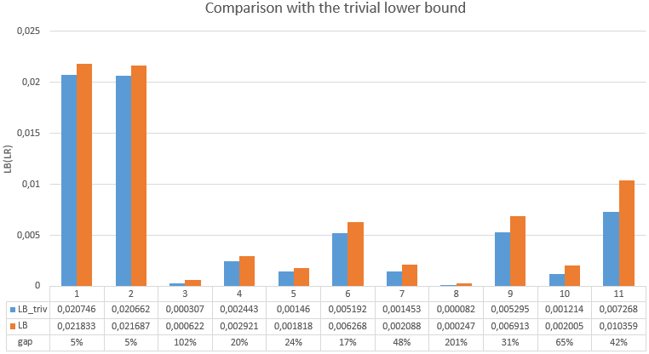
Lower Bound LR-IRP
(Junior Prize winner)
Results:
In average the lower bound found improve by 51% the basic lower bound computed in TENOR.
Complexity:
The maximal number of delivered customers of base patterns is high when customers' capacities are small
The maximal number of delivered customers is also the maximal size of the traveler salesman problem that we need to solve for each base pattern in order to calculate t(P) and c(P).

Slide 20
4
What next? Follow-up of the challenge: Proposed action Plan

Slide 21

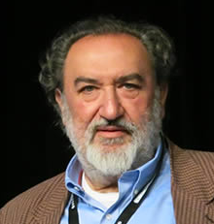

Practical Short term collaboration options
Potential Short term collaborations (in 2018) with Lancaster University (new University for Ahmed Kheiri):
Center for Transport & Logistics at Lancaster University http://www.lancaster.ac.uk/lums/central/ led by Konstantinos Zografos http://www.lancaster.ac.uk/lums/people/konstantinos-zografos
Collaborative studies with Ahmed to improve the current solutions by performing new experimentations to completing assessment the full potential of the hyperheuristics approach:
injecting initial solutions provided by AL to be improved by the hyperheuristics (instead of spending too much time on the feasibility phase)
providing new moves that work well to complete the set of Lower Level Heuristics
injecting/reusing previous transition matrices for each optimization phase to check efficiency improvements (instead of starting from scratch)
Code sharing. In order to able to move further in the knowledge of the code and its tuning:
checking the possibility to have a licence to share/access the code through a fee or open source :
if access, test on other case studies (large scale) to experiment
evaluate potential code evolutions

Slide 22



Practical mid-term PhD (2018-2020) collaboration options
LIRMM http://www.lirmm.fr/ (Computer Science Lab @ Montpellier University) to leverage the knowledge developed within the MAORE team http://www.lirmm.fr/lirmm_eng/research/teams/maore
Advantages: the team is familiar with the problem :
Prof Eric Bourreau (Head of the Challenge committee)
Prof Rodolphe Giroudeau (Junior Prize Winner Supervisor)
Cons:
PhD student Jr Prize Winner Tamara Jovanovic has stopped her PhD
Logistically difficult
LIX https://www.lix.polytechnique.fr/ (Computer Science Lab @ Ecole Polytechnique)
Advantages:
Extending our current research collaborations around Ecole Polytechnique (on going PhD in Data Science with CMAP - Applied Math Lab)
Prof Leo Liberti is a a top Combinatorial Optimization Professor , Former IBM Watson Researcher
Cons: less familiar with the topic but very fast at identifying the key challenges

Slide 23
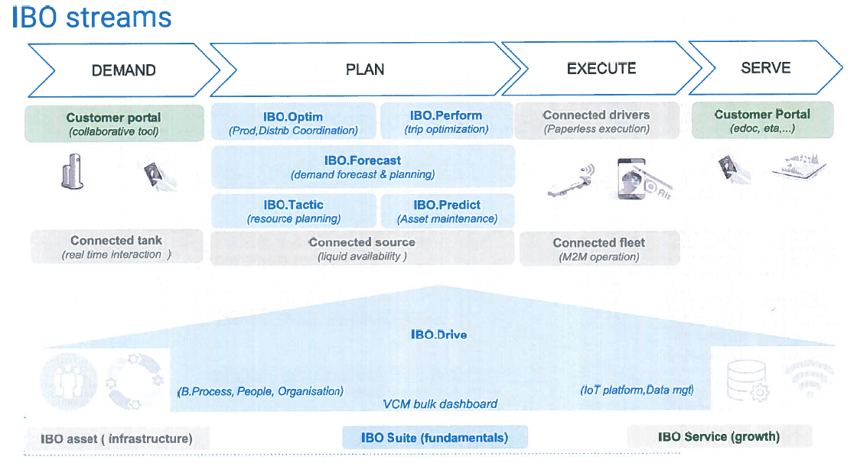
To tackle challenges in line with IBO R&D project

Slide 24
To tackle challenges in line with IBO R&D project
IBO.Perform: Interactive Trip Optimizer Next generation
Build operational solutions that can be implemented with dispatchers knowledge
On line improvement of meta heuristics by using learning techniques to improve the success factor of combination of Low Level Heuristics
Off line Model Learning by identifying the key features of past routes selected by the dispatchers.
Optimality Gap to close: explore/improve lower bounds for extended industrial instances (larger with more constraints than the challenge instances) to measure the performance of current solutions
IBO.Connect & IBO.Forecast : Dynamic Inventory Routing Problem:
Time uncertainty management (travel and delivery times)
Demand uncertainty management (forecasts inaccuracy, call in customers)
End of horizon management with tank level target management for predictable or unpredictable events beyond the end of horizon.

Slide 25
Thank you

